Slide 1

Financial Performance Analysis of Netflix 2002 - 2022 and Growth Forecasts
Presenters: Trang Nguyen & Qi Wang
Mercer University Stetson School of Business

Slide 2

BACKGROUND
DATA DESCRIPTION
DATA VISUALIZATION ANALYSIS
CONCLUSION

Slide 3
Netflix: a dominant company in on-demand media industry.
Company’s market value: $ 142.99 billion USD ¹
BACKGROUND
1. How many countries is Netflix available in?
2. How many paid subscribers does Netflix have?
3. What is the annual Netflix Gross Income and Profits ?
4. Is there any relationship as well as correlations between financial performance of the company and subscriber growth?
5. What will the future performance of Netflix in 5 years?
Understand consumer behavior, market trends & company’s business strategy
To get valuable insight of the company’s business and its future prospects.
RESEARCH QUESTION
STUDY GOALS

Slide 4
DATA DESCRIPTION
Data Source
Statista
Dataset: 21 rows, 11 columns, 21 observations, & 11 variables.
The target variables in this dataset:
Categorical variables: “ Regions”, “ Countries”, “Subscriber Groups”
Continuous variables: “Number of Subscribers” “Gross Income”, “Marketing Expenses”, “Profits”
Data Type

Slide 5
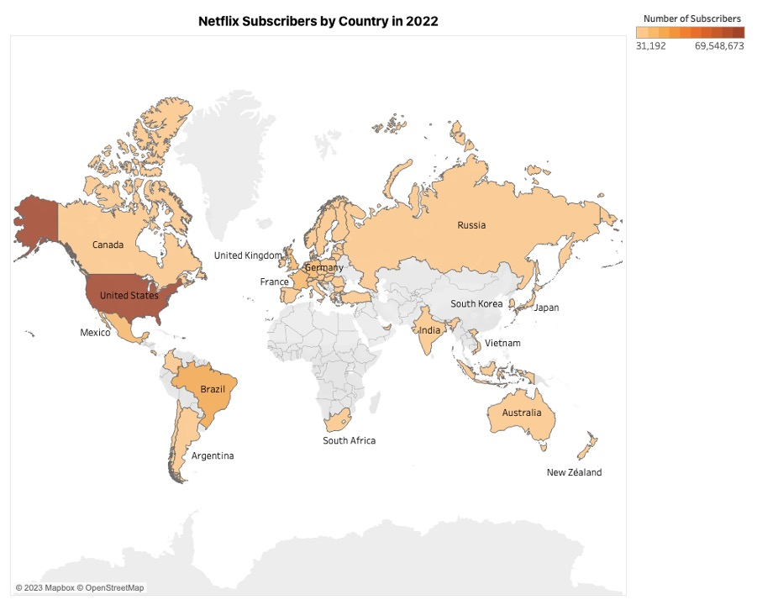
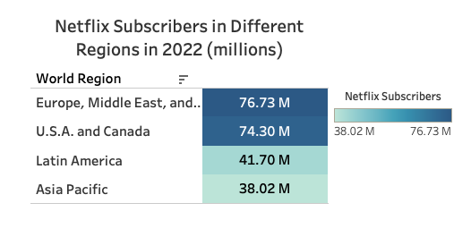
DATA VISUALIZATION ANALYSIS
Netflix: streaming > 190 countries ²
# of Subscribers

Slide 6
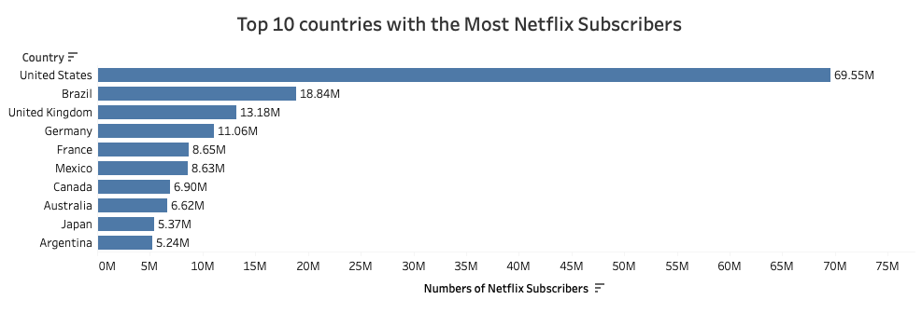
DATA ANALYSIS

Slide 7
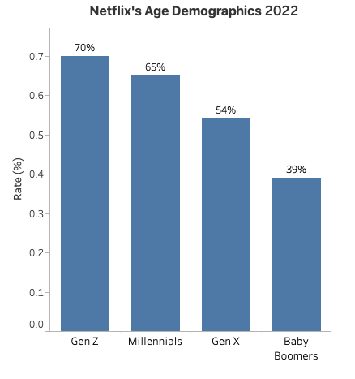
DATA ANALYSIS
Netflix’s audience: more popular with younger consumers than with older generations.

Slide 8
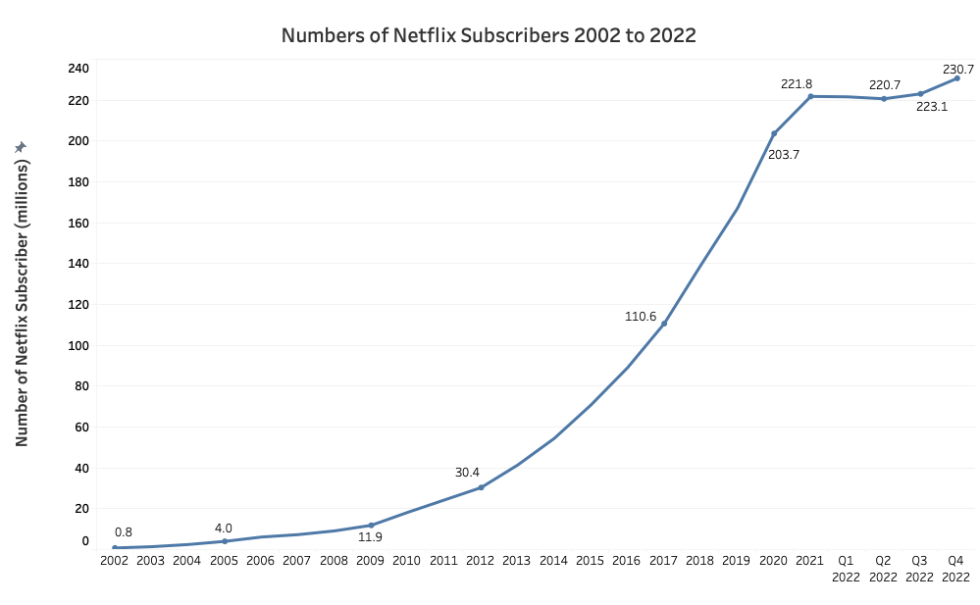
DATA ANALYSIS
Year
2Q 2022: nearly a 1 million subscribers loss between April and July
Why was Netflix Losing Subscribers?
Due to the war in Ukraine, the company decided to stop its activity in Russia
Subscription price increasing in the United States and Canada
Too many competitors - streaming services available ³

Slide 9
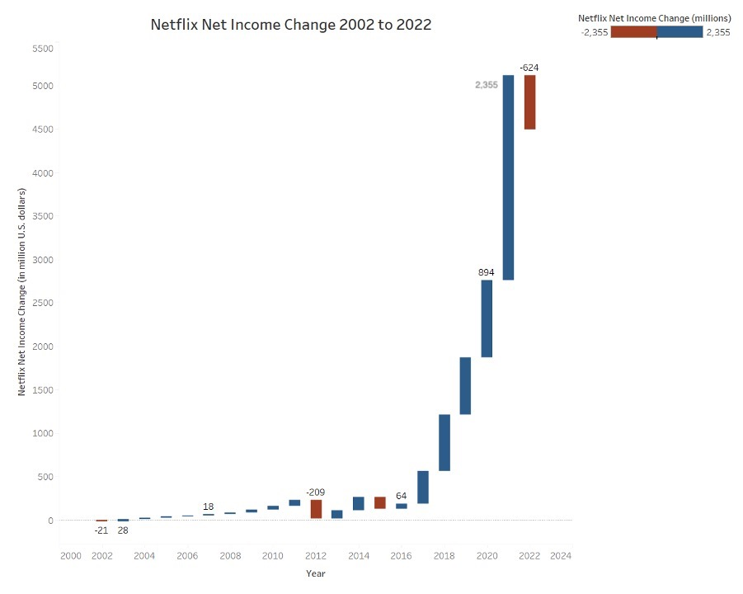
DATA ANALYSIS
In 2002, primarily focused on growing DVD rental business ⁴.
Company's expenses exceeded revenue from DVD rentals, resulting in a negative net income in 2022
In 2021, company’s profit: $5,116.23 millions.
In 2022, company’s profit was $ 4491.92 millions, a $624 millions decline from 2021

Slide 10
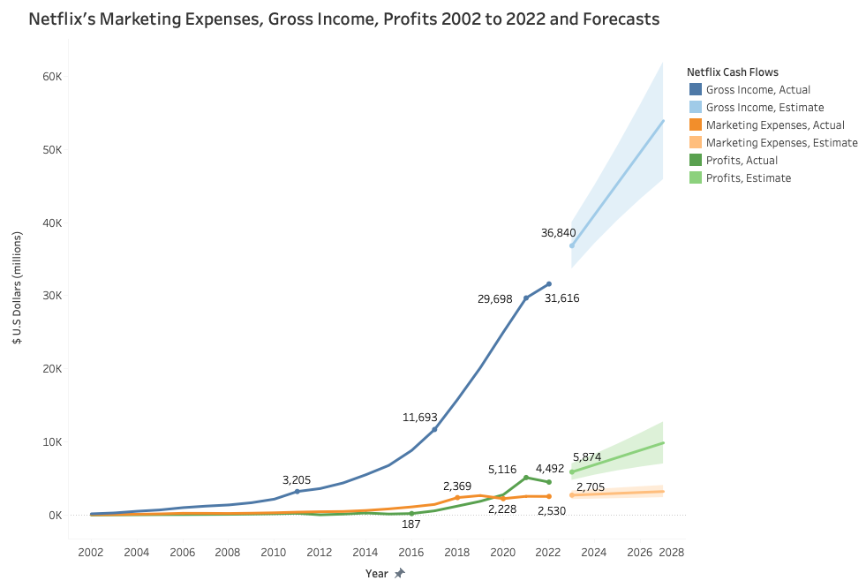
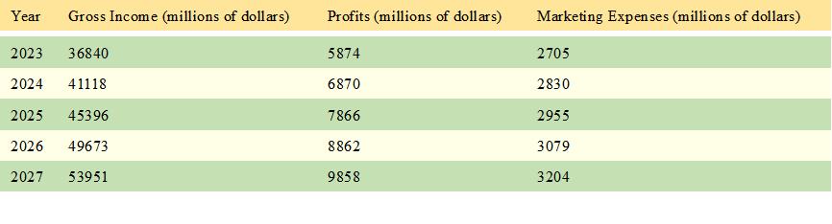
DATA ANALYSIS
Three variables: show relatively stable growth since 2002.

Slide 11
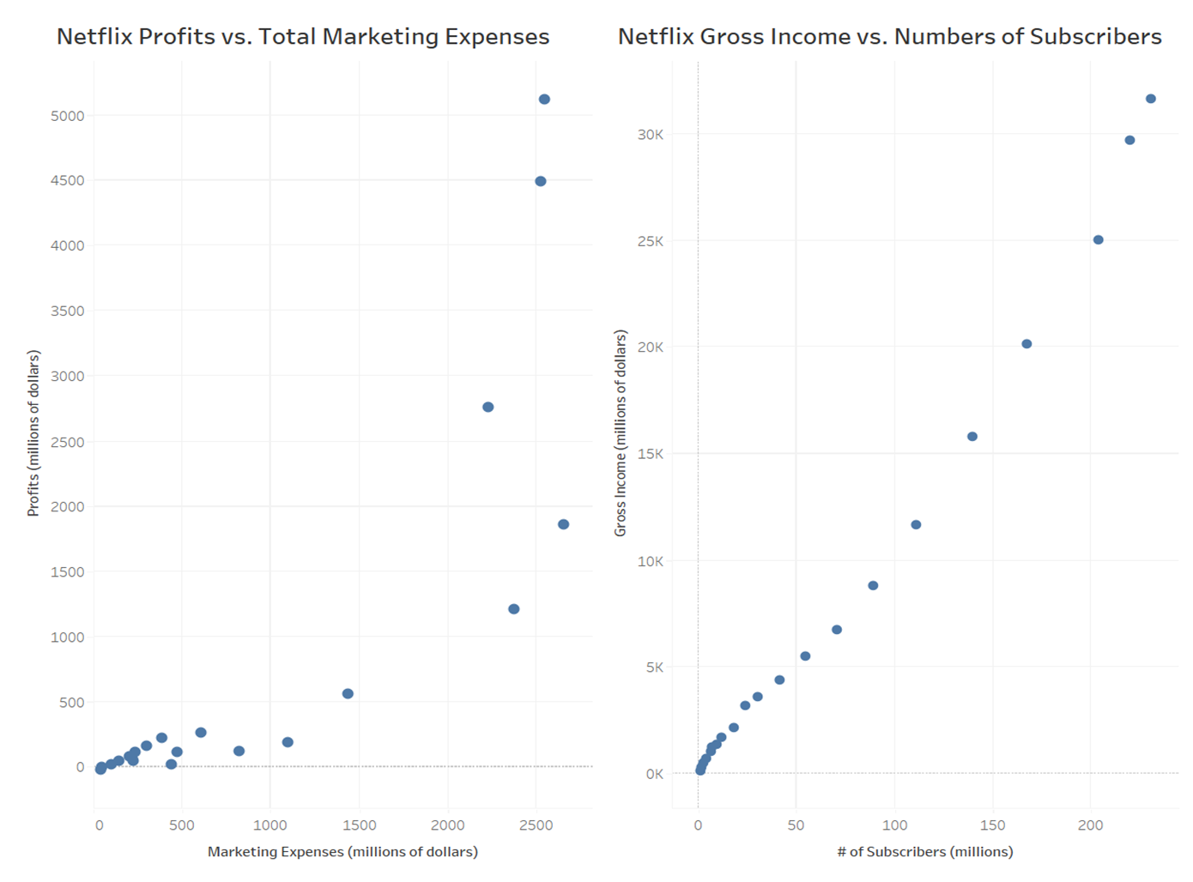
DATA ANALYSIS

Slide 12
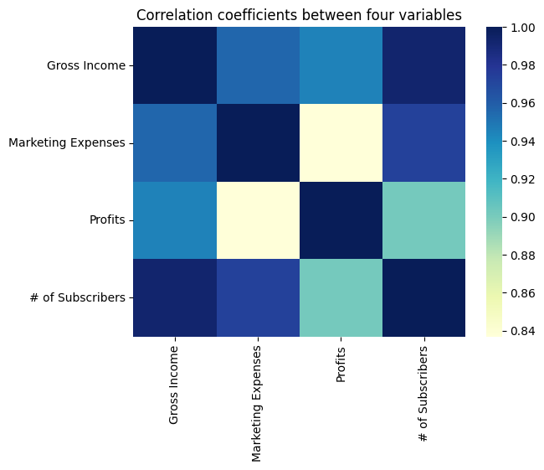
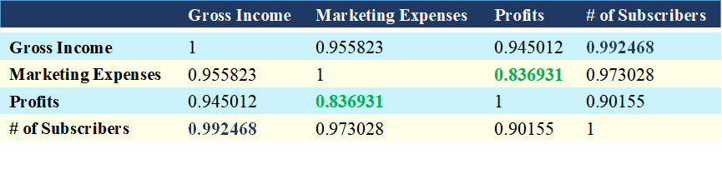
DATA ANALYSIS
A strong positive correlation between these variables

Slide 13
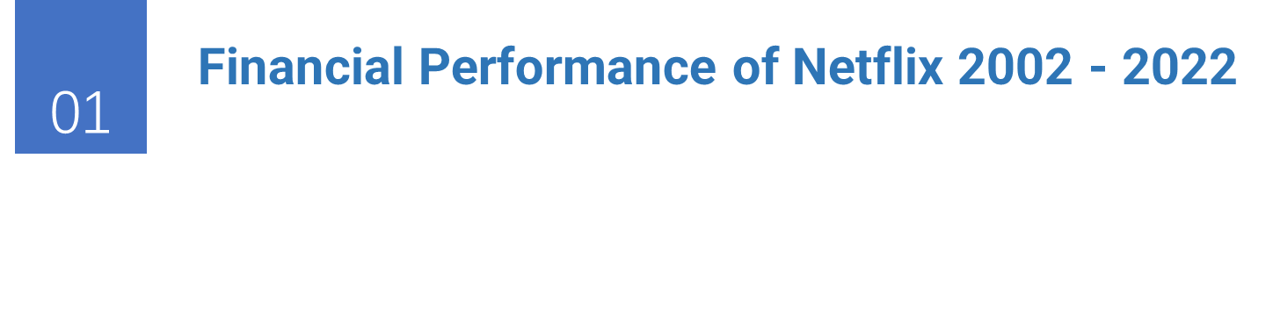




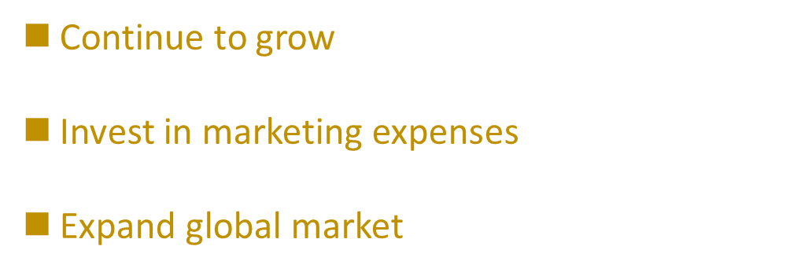
CONCLUSION

Slide 14
REFERENCES
Market capitalization of Netflix (NFLX). https://companiesmarketcap.com/netflix/marketcap/
2. Countries where Netflix is available . https://help.netflix.com/en/node/14164
3. Netflix Loses Almost a Million Subscribers in Last Quarter. https://www.globaldata.com/data-insights/technology--media-and-telecom/netflix-loses-almost-a-million-subscribers-in-last-quarter/#:~:text=In%20April%202022%2C%20the%20company,loss%20between%20April%20and%20July.
4. From DVDs to streaming, here's the incredible history of Netflix. https://interestingengineering.com/culture/the-fascinating-history-of-netflix

Slide 15
Thank You
Presenters: Trang Nguyen & Qi Wang

